Slide 1
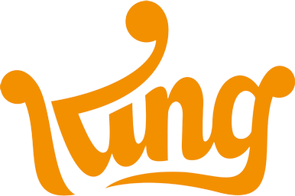
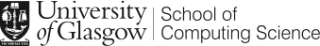
Kingternship
Seriously Playful Software engineering
Andrei-mihai Nicolae
2147392

Slide 2
Overview
Introduction
Company, Team, My role in the Kingdom
Technologies and Practices
Agile Practices, Change Management, Quality Assurance
Reflection
Challenges, How university helped me, Takeaways

Slide 3
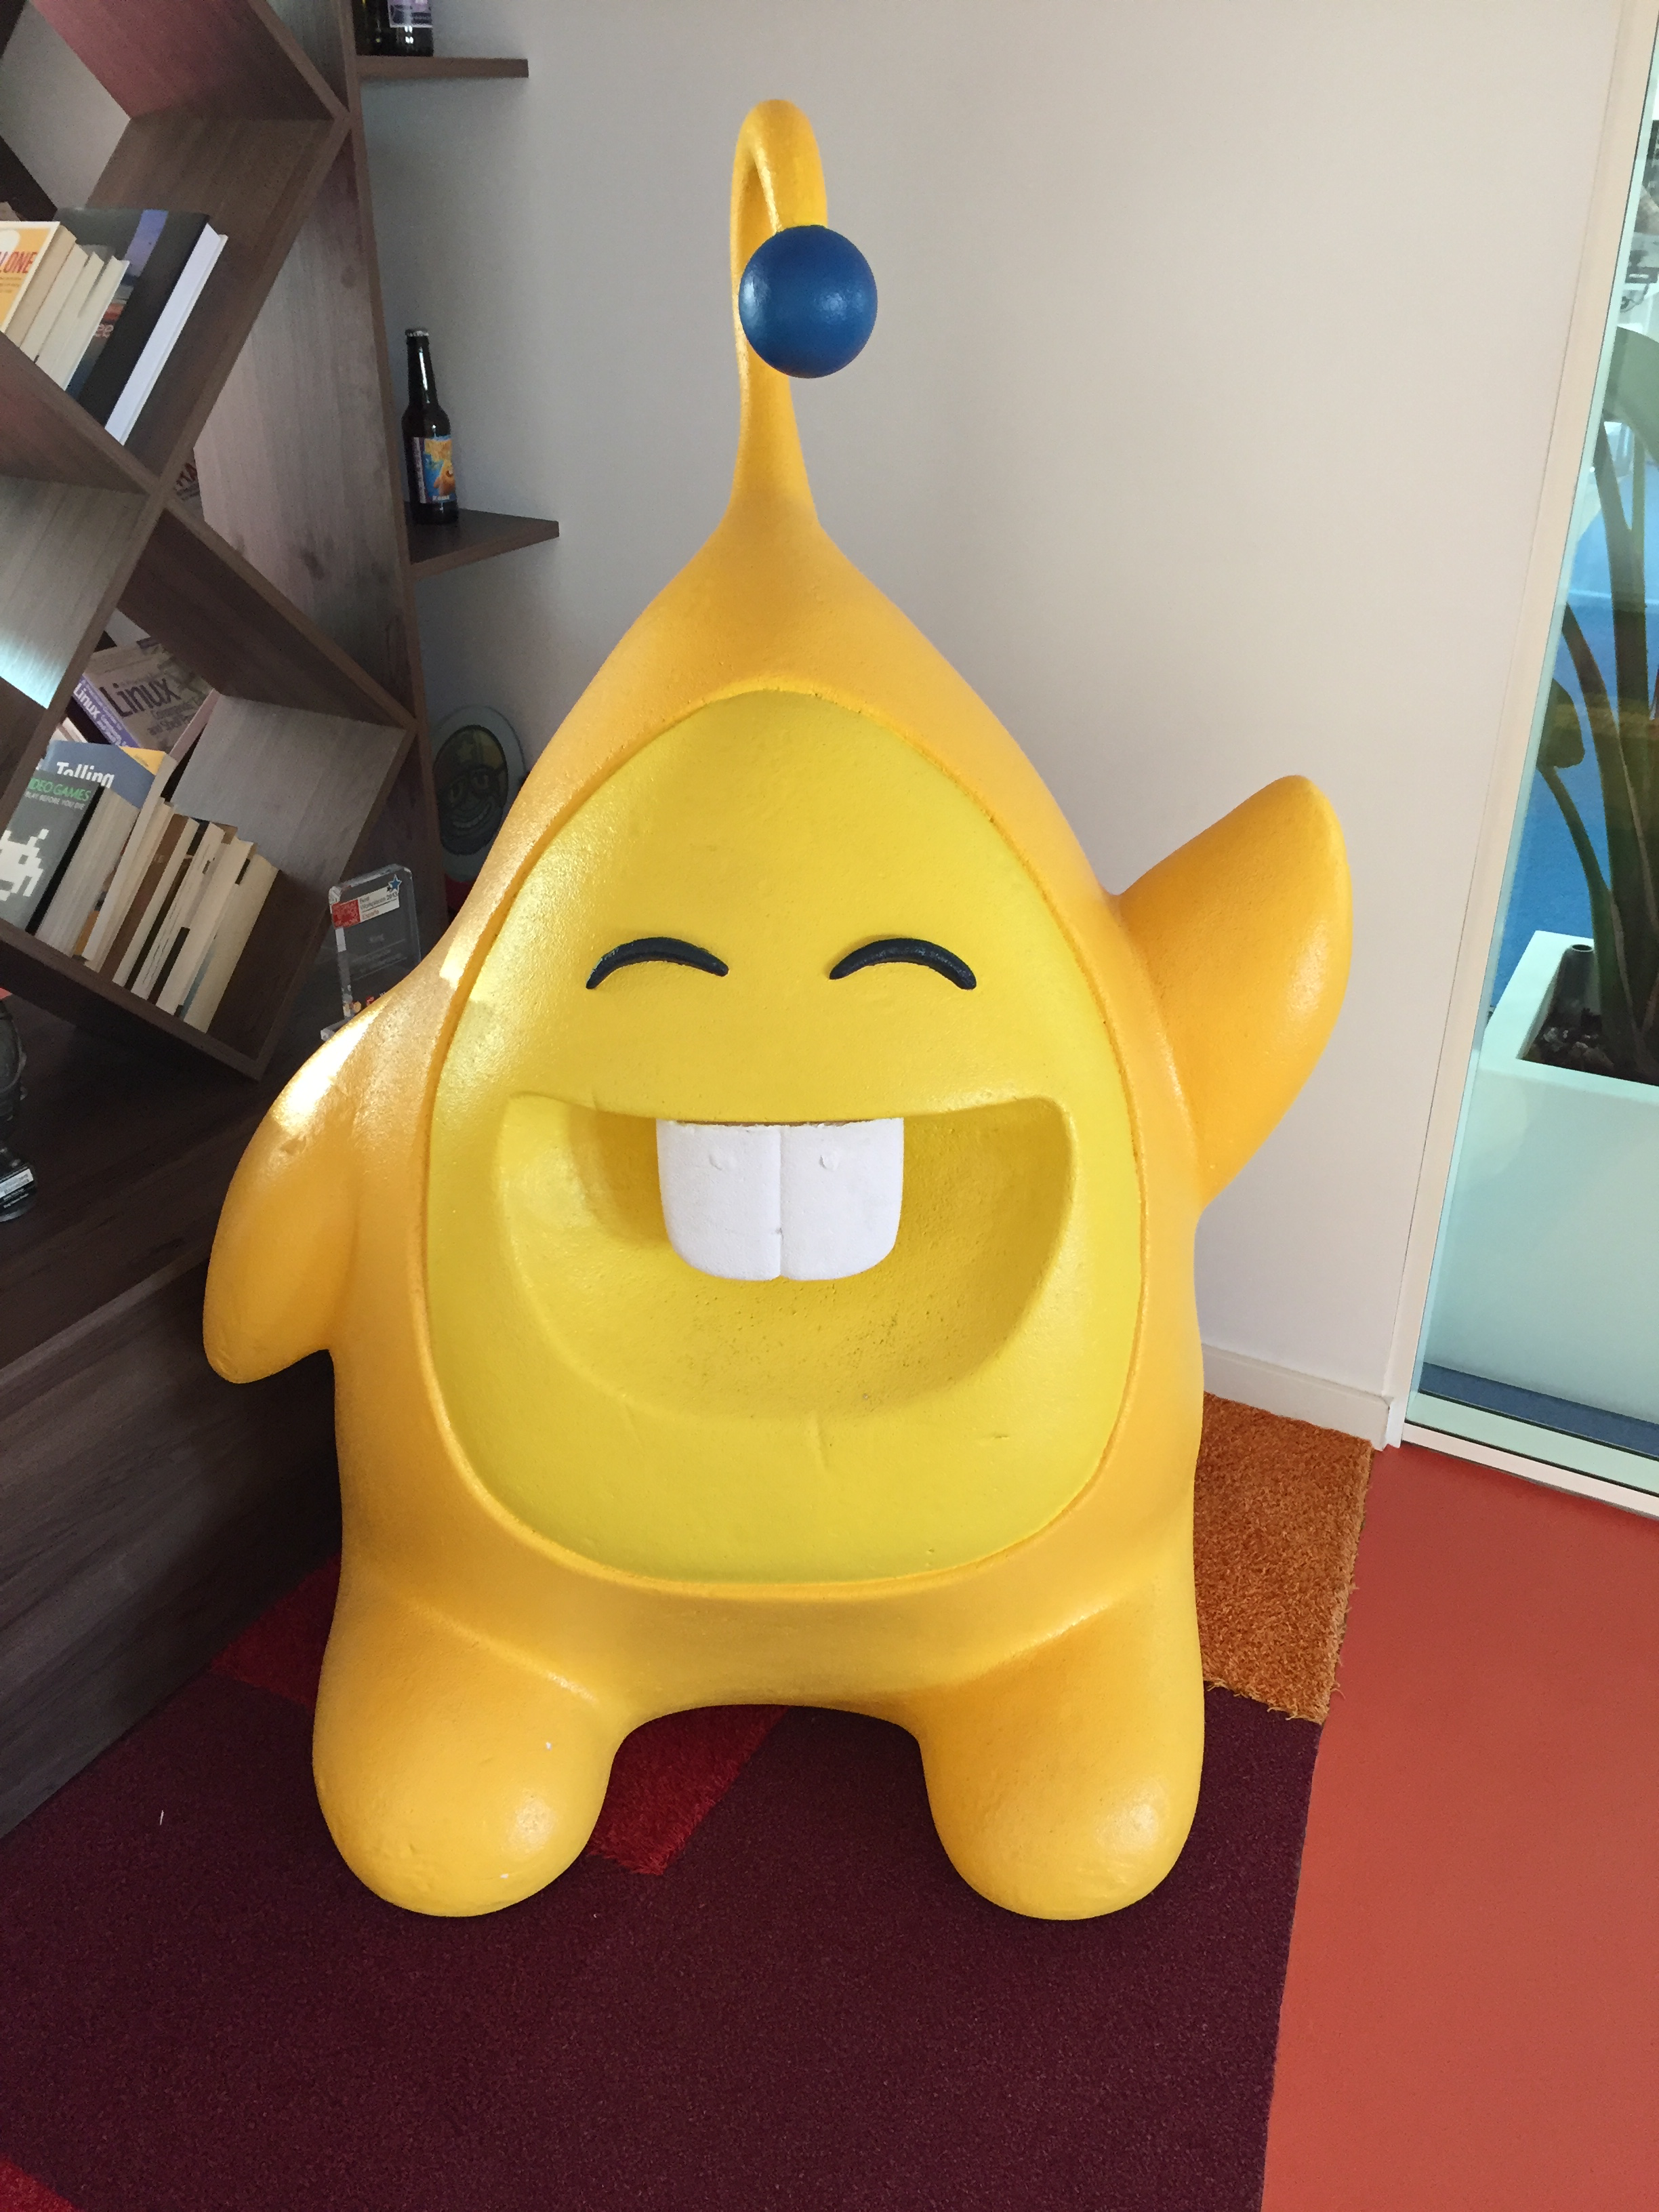
Who is King?
Swedish mobile games development company
One of the top in the market; recently acquired by Activision Blizzard
Maker of Candy Crush, Farm Heroes and Bubble Witch Sagas

Slide 4
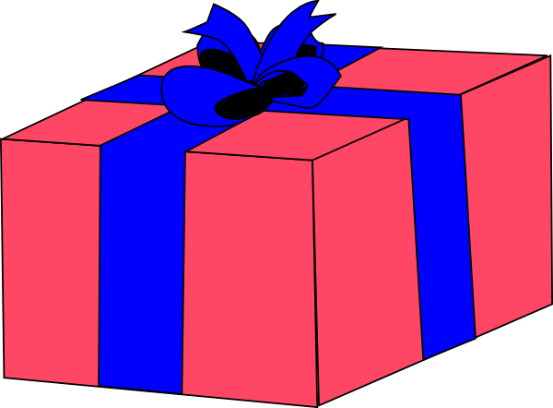
My Team
Part of Gifting Team
Developing flow through which King players receive gifts
Agile team of 8 people working in the same workspace

Slide 5
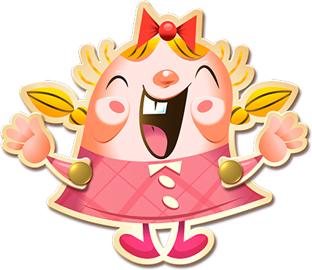
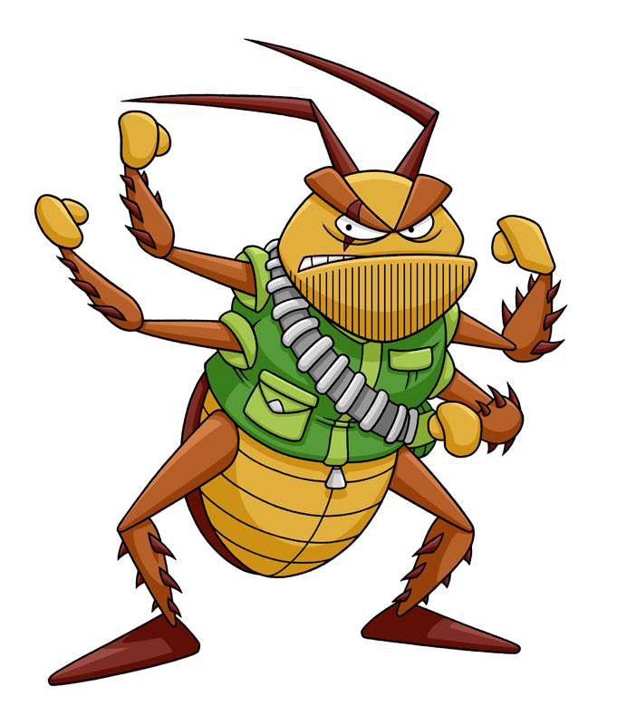
My role as a kingtern
Full-stack software developer
Worked directly on the interface through which gifting campaigns could be launched
Released > 25 features into production
Solved many, many bugs…

Slide 6
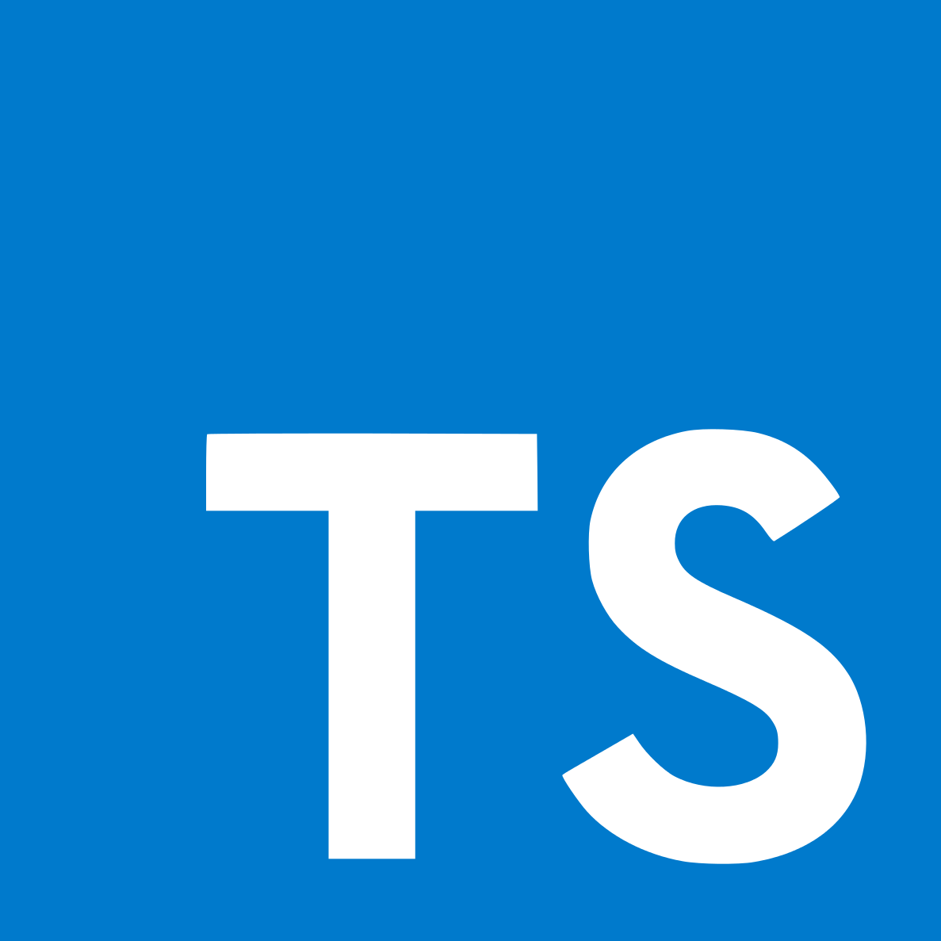


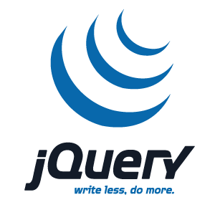
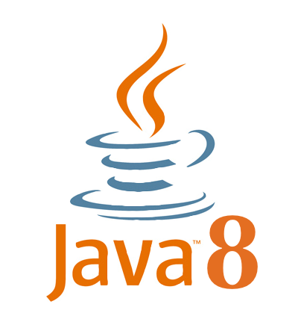
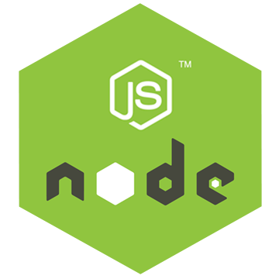
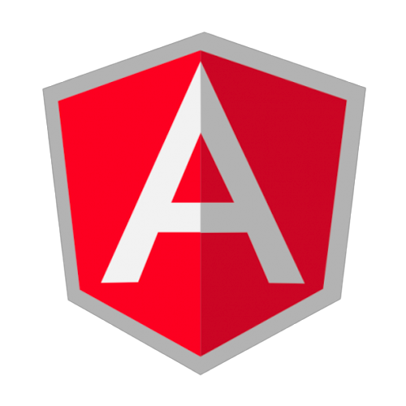


Technologies

Slide 7
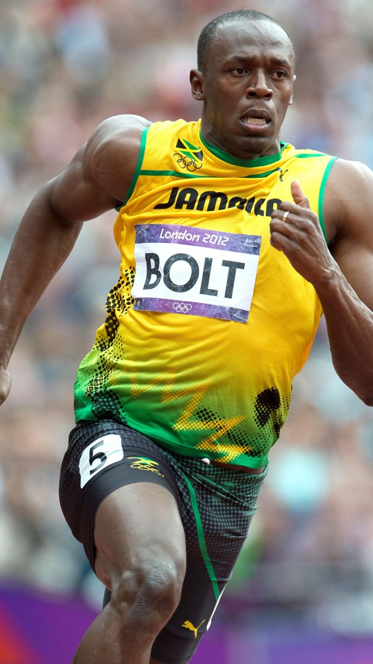
Agile Practices
Weekly sprints with daily stand-ups
Retrospectives every 2 months (maybe not so Agile?)
Weekly code reviews
Monthly off-sites

Slide 8

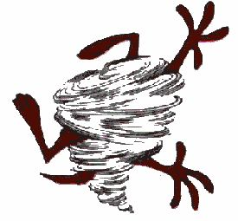
Change management
SVN for PSD+TP
Team was pushing to dev branch
Integration Hell
Git in tandem with SourceTree as GUI
Feature branches for new major functionality
Frequent merges back to dev branch
Used hotfixes and released every 2-3 weeks

Slide 9
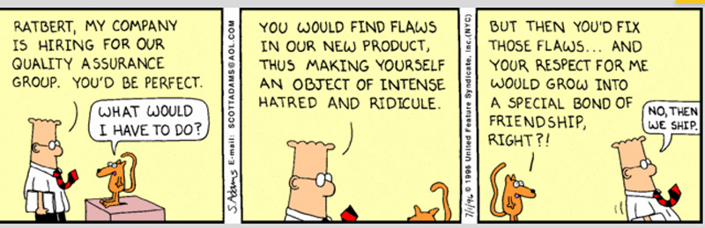
Quality assurance
Used mocking as part of unit testing
Implemented smoke, regression and mutation tests
Attended weekly QA firm-wide meetings

Slide 10
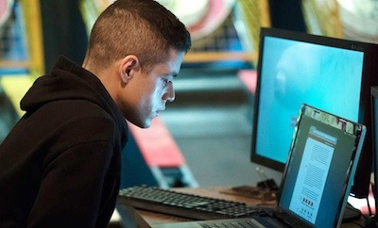
Challenges
No source code documentation - struggling at the start of the placement
Working only with latest technologies
Code reviews seem tough at first
Difference in scale and organisation

Slide 11
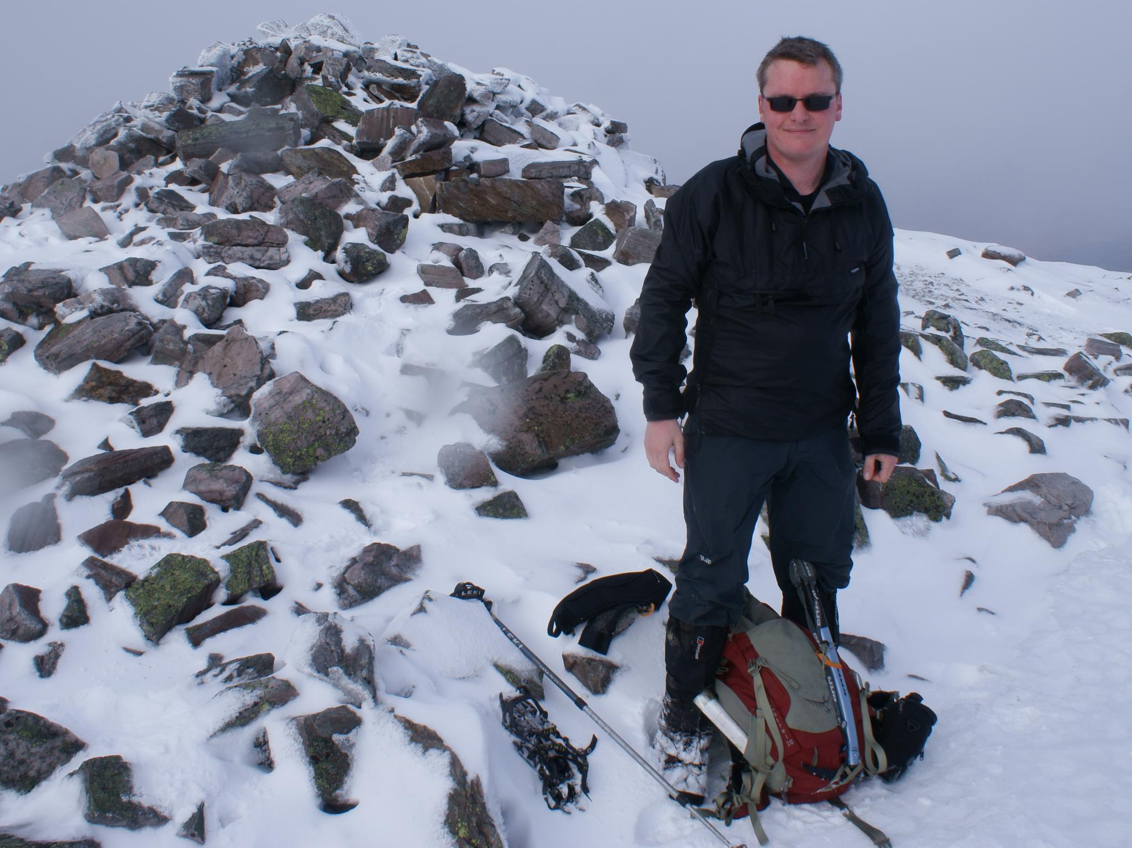

How did the university help me?
Tim and PSD+TP course have helped me tremendously
For frontend - used several HCI techniques learnt during university
For backend - many concepts from a variety of courses (NS, AP, DB…)

Slide 12
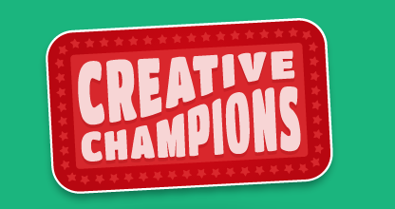
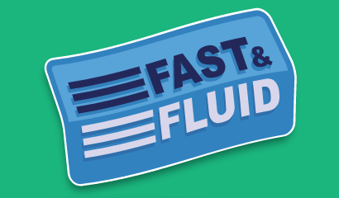
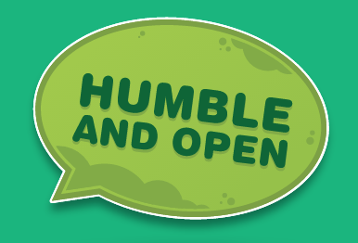
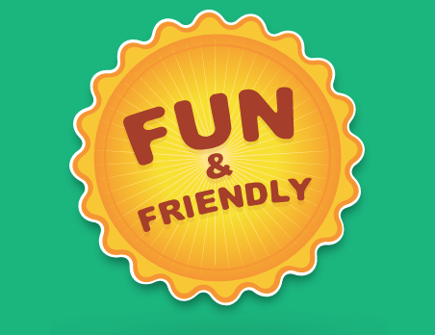
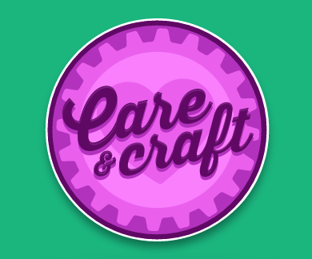
what did the kingdom teach me?

Slide 13
Thank you for your attention!
for any further questions (or advice) email me: a.mihai.nicolae@gmail.com

